Slide 1
Python Assignment
ATM Operations Model with Python
Presentation by :
Srikanth Panguluri

Slide 2
Aim & Tasks
Aim :To draft a python programme to perform ATM operations
Tasks:
Creating user data base in CSV file
Choosing the operations user want to perform
Writing programme in VS code
Testing the programme & Update database automatically

Slide 3
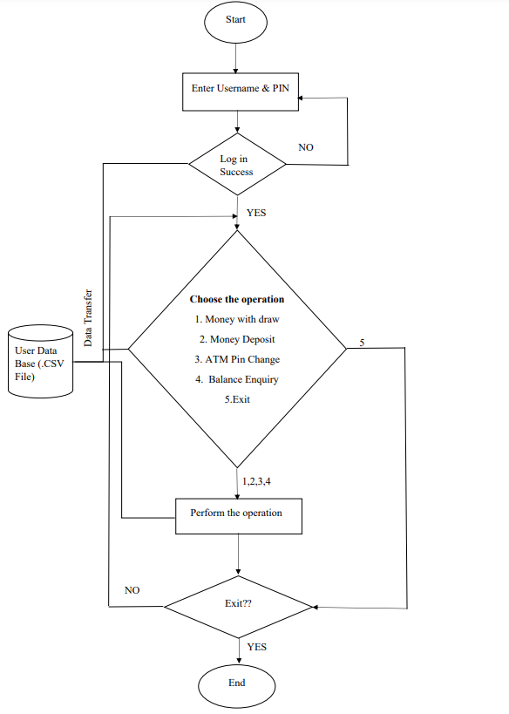
Process Flow

Slide 4
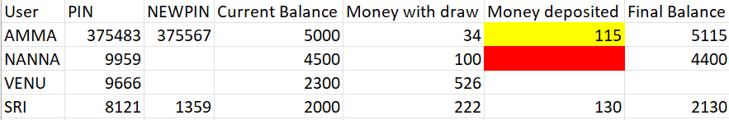
USER DATA BEFORE OPERATION
These details will get updated according to the operations performed by user

Slide 5
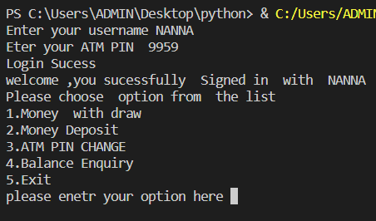
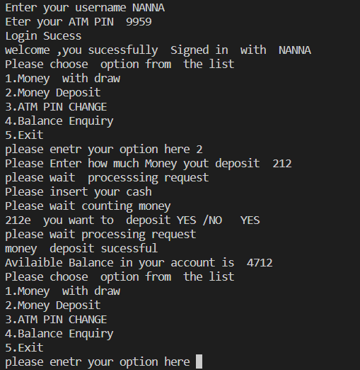
USER INTERFACE

Slide 6
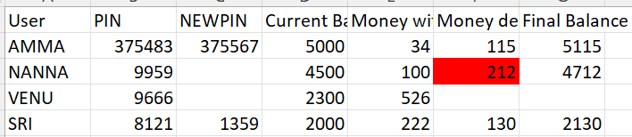
USER DATA AFTER OPERATION

Slide 7
SCOPE OF IMPROVEMENTS
We may include log in verification with mail id
Can provide monthly statement to user
User can see the ‘log in’ history
Can restrict user transactions with daily/monthly limits

Slide 8
Any Queries
?

Slide 9
THANK YOU

